Slide 1

COMP90050
Advanced Database Systems
Winter Semester, 2023
Lecturer: Farhana Choudhury (PhD)
Week 3 part 1-2

Slide 2
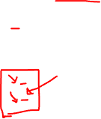


Core Concepts of Database management system
Efficiency
Database performance metrics
Hardware
Software/ DB tuning
Efficiency/speed
Effectiveness
Effectiveness
Concurrent users
Users reading and writing over the same data
Security & Reliability
Transactions
Required tasks are all done together
Reliability
Crash recovery
Fault tolerance
Data duplication

Slide 3
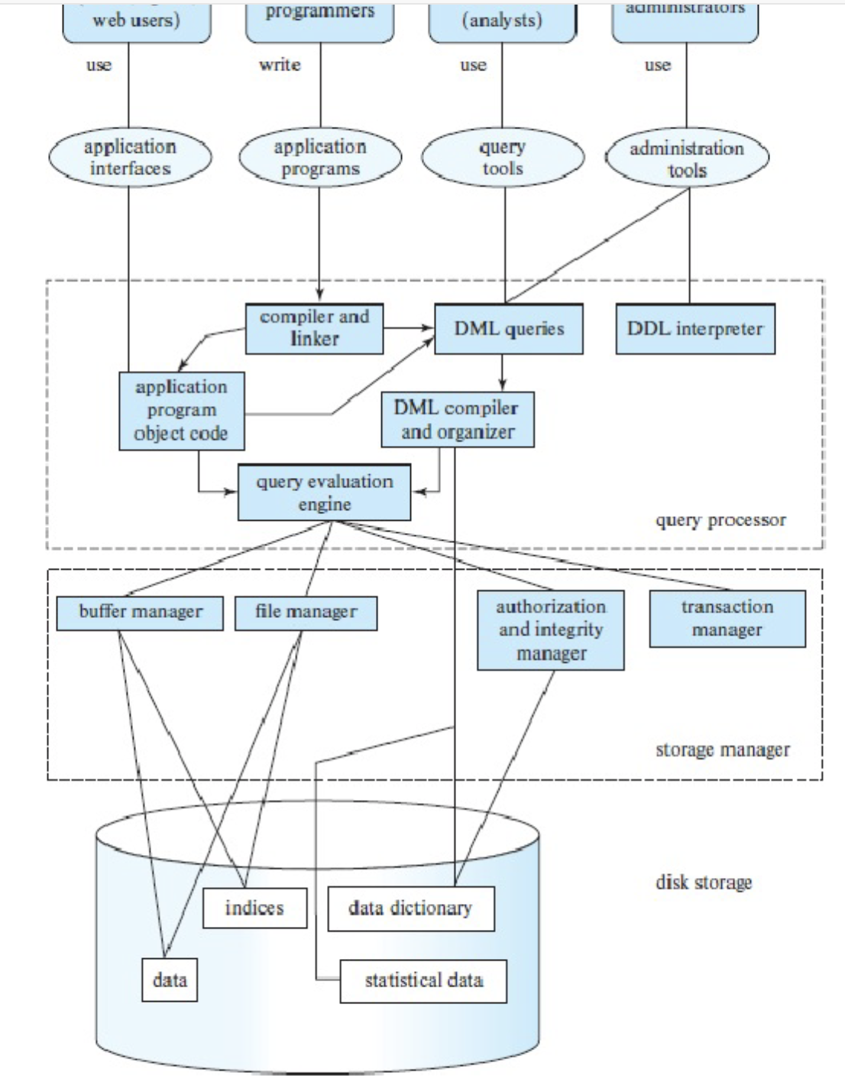

Database Engine
Notes:
Query optimization – we will look. Buffer and file manager – yes. Storage manager and transaction – concurrency control. Multiple people accessing, fig 1.3. chap 1.6

Slide 4

Topics
Transaction concepts
Different types of transactions
Concurrent use of data and its issues
Isolation concepts - ensuring that concurrent transactions leaves the DB in the same state as if they were executed separately
How to achieve isolation while keeping good efficiency

Slide 5
Database Transactions
Transaction - A unit of work in a database
A transaction can have any number and type of operations in it
Either happens as a whole or not
Transactions ideally have four properties, commonly known as ACID properties

Slide 6
Transaction models
ACID (Atomicity, Consistency, Isolation, Durability) properties:
Atomicity - All changes to data are performed as if they are a single operation. That is, all the changes are performed, or none of them are.
Example – A transaction that (i) subtracts $100 if balance >100 (ii) deposits $100 to another account
(both actions with either happen together or none will happen)

Slide 7
Transaction models
ACID (Atomicity, Consistency, Isolation, Durability) properties:
Consistency - Data is in a ‘consistent’ state when a transaction starts and when it ends – in other words, any data written to the database must be valid according to all defined rules (e.g., no duplicate student ID, no negative fund transfer, etc.)
  What is ‘consistent’ - depends on the application and context constraints
  It is not easily computable in general
  Only restricted type of consistency can be guaranteed, e.g. serializable transactions which will be discussed later.

Slide 8
Transaction models ...
ACID (Atomicity, Consistency, Isolation, Durability) properties:
Isolation- transaction are executed as if it is the only one in the system.
  For example, in an application that transfers funds from one account to another, the isolation ensures that another transaction sees the transferred funds in one account or the other, but not in both, nor in neither.
Durability- the system should tolerate system failures and any committed updates should not be lost.

Slide 9
Transaction models (cont.)
Types of Actions
  - Unprotected actions - no ACID property
  - Protected actions - these actions are not externalised before they are completely done. These actions are controlled and can be rolled back if required. These have ACID property.
  - Real actions - these are real physical actions once performed cannot be undone. In many situations, atomicity is not possible with real actions (e.g., firing two rockets as a single atomic action)

Slide 10
Let’s look at a simple example that will be used to understand different types of transactions …

Slide 11
Embedded SQL example in C
(Open Database Connectivity)
int main()
{ exec sql INCLUDE SQLCA; /*SQL Communication Area*/
exec sql BEGIN DECLARE SECTION;
/* The following variables are used for communicating between SQL and C */
int OrderID; /* Employee ID (from user) */
int CustID; /* Retrieved customer ID */
char SalesPerson[10] /* Retrieved salesperson name */
char Status[6] /* Retrieved order status */
exec sql END DECLARE SECTION;
/* Set up error processing */
exec sql WHENEVER SQLERROR GOTO query_error;
exec sql WHENEVER NOT FOUND GOTO bad_number;

Slide 12
/* Prompt the user for order number */
printf ("Enter order number: ");
scanf_s("%d", &OrderID);
/* Execute the SQL query */
exec sql SELECT CustID, SalesPerson, Status
FROM Orders
WHERE OrderID = :OrderID // ”:” indicates to refer to C variable
INTO :CustID, :SalesPerson, :Status;
/* Display the results */
printf ("Customer number: %d\n", CustID);
printf ("Salesperson: %s\n", SalesPerson);
printf ("Status: %s\n", Status);
exit();
query_error:
printf ("SQL error: %ld\n", sqlca->sqlcode); exit();
bad_number:
printf ("Invalid order number.\n"); exit(); }

Slide 13
Some concepts…
Host Variables
  Declared in a section enclosed by the BEGIN DECLARE SECTION and END DECLARE SECTION. While accessing these variables, they are prefixed by a colon “:”. The colon is essential to distinguish between host variables and database objects (for example tables and columns).
Data Types
  The data types supported by a DBMS and a host language can be quite different. Host variables play a dual role:
  - Host variables are program variables, declared and manipulated by host language statements, and
  - they are used in embedded SQL to retrieve database data.
  If there is no host language type corresponding to a DBMS data type, DBMS automatically converts the data. So, the host variable types must be chosen carefully.

Slide 14
Error Handling
  The DBMS reports run-time errors to the applications program through an SQL Communications Area (SQLCA) by INCLUDE SQLCA. The WHENEVER...GOTO statement tells the pre-processor to generate error-handling code to process errors returned by the DBMS.
Singleton SELECT
  The statement used to return the data is a singleton SELECT statement; that is, it returns only a single row of data. Therefore, the code example does not declare or use cursors.
  Reference: http://msdn.microsoft.com/enus/library/ms714570(VS.85).aspx

Slide 15
Flat Transaction
exec sql CREATE Table accounts (
    AccId NUMERIC(9),
    BranchId NUMERIC(9), FOREIGN KEY REFERENCES branches,
    AccBalance NUMERIC(10),
    PRIMARY KEY(AccId));
************************************
Everything inside BEGIN WORK and COMMIT WORK is at the same level; that is, the transaction will either survive together with everything else (commit), or it will be rolled back with everything else (abort)

Slide 16
Flat Transaction ...
exec sql BEGIN DECLARE SECTION;
long AccId, BranchId, TellerId, delta, AccBalance;
exec sql END DELCLARATION;
/* Debit/Credit Transaction*/
DCApplication()
{read input msg;
  exec sql BEGIN WORK;
  AccBalance = DodebitCredit(BranchId, TellerId, AccId, delta);
  send output msg;
  exec sql COMMIT WORK;
}

Slide 17
/* Withdraw money -- bank debits; Deposit money – bank credits */
Long DoDebitCredit(long BranchId,
long TellerId, long AccId, long AccBalance, long delta){
    exec sql UPDATE accounts
    SET AccBalance =AccBalance + :delta
    WHERE AccId = :AccId;
    exec sql SELECT AccBalance INTO :AccBalance
    FROM accounts WHERE AccId = :AccId;
    exec sql UPDATE tellers
    SET TellerBalance = TellerBalance + :delta
    WHERE TellerId = :TellerId;
    exec sql UPDATE branches
    SET BranchBalance = BranchBalance + :delta
    WHERE BranchId = :BranchId;
    Exec sql INSERT INTO history(TellerId, BranchId, AccId, delta, time)
    VALUES( :TellerId, :BranchId, :AccId, :delta, CURRENT);
  return(AccBalance);
}

Slide 18
Let’s include a check on the account balance and refusing any debit that overdraws the account.
…
DCApplication(){
read input msg;
  exec sql BEGIN WORK;
  AccBalance = DodebitCredit(BranchId, TellerId, AccId, delta);
  if (AccBalance < 0 && delta < 0){
  exec sql ROLLBACK WORK;
  }
  else{
  send output msg;
  exec sql COMMIT WORK;
  }
}

Slide 19
Limitations of Flat Transactions
Flat transactions do not model many real applications.
  E.g. airline booking
  BEGIN WORK
  S1: book flight from Melbourne to Singapore
  S2: book flight from Singapore to London
  S3: book flight from London to Dublin
  END WORK
  Problem: from Dublin if we cannot reach our final destination instead we wish to fly to Paris from Singapore and then reach our final destination.
  If we roll back we need to re do the booking from Melbourne to Singapore which is a waste.

Slide 20
Limitations of Flat Transactions ...
IncreaseSalary()
{ real percentRaise;
receive(percentRaise);
exec SQL BEGIN WORK;
exec SQL UPDATE employee
set salary = salary*(1+ :percentRaise)
send(done);
exec sql COMMIT WORK;
return
}
This can be a very long running transaction. Any failure of transaction requires lot of unnecessary computation.

Slide 21
Flat transaction with save points
BEGIN WORK
SAVE WORK 1
Action 1
Action 2
SAVE WORK 2
Action 3
Action 4
Action 5
SAVE WORK3
Action 6
Action 7
ROLLBACK WORK(2)
Action 8
Action 9
SAVE WORK4
Action 10
Action 11
SAVE WORK 5
Action 12
Action 13
ROLLBACKWORK(5)
Reading - Chained transactions
Notes:
A savepoint is established by invoking the SAVE WORK function, which causes the system to record the current state of processing (this is explained in detail in Chapters 10 and 11). This returns to the application program a handle that can subsequently be used to refer to that savepoint. Typically, the handle is a monotonically increasing number. The only reason why an application program needs an identifier for a savepoint is that it may later want to reestablish (return to) that savepoint. To do that, the application invokes the ROLLBACK WORK function, but rather than requesting the entire transaction to be aborted, it passes the number of the savepoint it wants to be restored. As a result, it finds itself reinstantiated at that very savepoint.

Slide 22
Nested Transactions
T1
BEGIN WORK
Invoke Sub Trans 11
Invoke Sub Trans 12
END WORK
BEGIN WORK
.
.
.
Invoke Sub Trans 1
.
.
Invoke Sub Trans 2
.
.
Invoke Sub Trans 3
T2
BEGIN WORK
Invoke Sub Trans 21
Invoke Sub Trans 22
END WORK
Notes:
Rather than taking a savepoint after each partial transfer, each of these subtransactions becomes a self-contained but dependent action (with the A, C, and I properties of ACID), which can be completed or rolled back individually

Slide 23
Nested Transaction Rules
Commit rule
- A subtransaction can either commit or abort, however, commit cannot take place unless the parent itself commits.
- Subtransactions have A, C, and I properties but not D property unless all its ancestors commit.
- Commit of a sub transaction makes its results available only to its parents.
Roll back Rules
If a subtransaction rolls back, all its children are forced to roll back.
Visibility Rules
Changes made by a subtransaction are visible to the parent only when the subtransaction commits. All objects of parent are visible to its children. Implication of this is that the parent should not modify objects while children are accessing them. This is not a problem as parent does not run in parallel with its children.
Reading – Open-nested transactions

Slide 24
Transaction Processing Monitor
The main function of a TP monitor is to integrate other system components and manage resources.
TP monitors manage the transfer of data between clients and servers
breaks down applications or code into transactions and ensures that all databases are updated properly
It also takes appropriate actions if any error occurs
Notes:
The size of what is perceived as a unit of work has a big influence on how resources should be allocated to such a unit and on the duration of allocation, how flexible this allocation decision must be, how much parallelism will go on in the system, how the system should behave in case of a crash, and so on.

Slide 25
TP monitor services
Heterogeneity: If the application needs access to different DB systems, local ACID properties of individual DB systems is not sufficient. Local TP monitor needs to interact with other TP monitors to ensure the overall ACID property. A form of 2 phase commit protocol must be employed for this purpose (will be discussed later).
Control communication: If the application communicates with other remote processes, the local TP monitor should maintain the communication status among the processes to be able to recover from a crash.

Slide 26
TP Services ...
Terminal management: Since many terminals run client software, the TP monitor should provide appropriate ACID property between the client and the server processes.
Presentation service: this is similar to terminal management in the sense it has to deal with different presentation ( user interface) software -- e.g. X-windows
Context management: E.g. maintaining the sessions etc.
Start/Restart: There is no difference between start and restart in TP based system.

